Slide 1
Project 3 (NLP/Reddit)
By Alex Simon

Slide 2

Pushshift API
Using this API I gathered information from two subreddits to compare the word usage on their threads. The subreddits I chose to compare were:
Mysterious Subreddit #1
Mysterious Subreddit # 2

Slide 3


Note:
Some users or Reddit itself removes content from threads for one reason or another. I took the following character strings out of all threads before doing anything else to avoid confusion with those words’ natural appearances in the threads:
[removed]
[deleted]
e.g. “Donald Trump should be removed from office.”

Slide 4
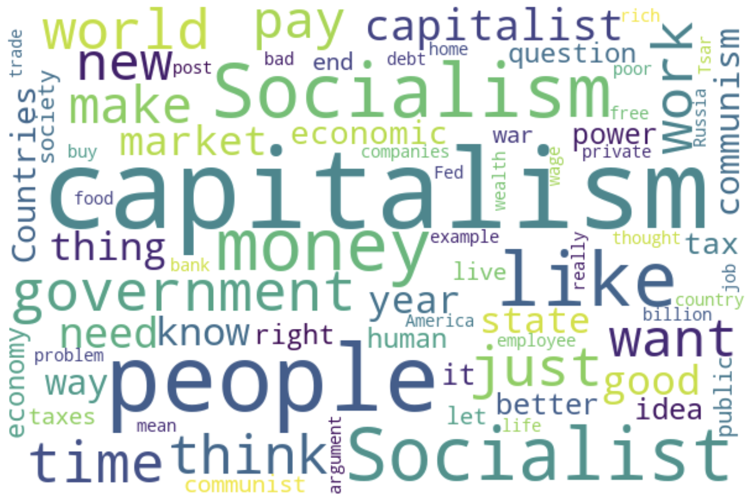

Slide 5
Mysterious Subreddit #1:
/r/capitalism

Slide 6
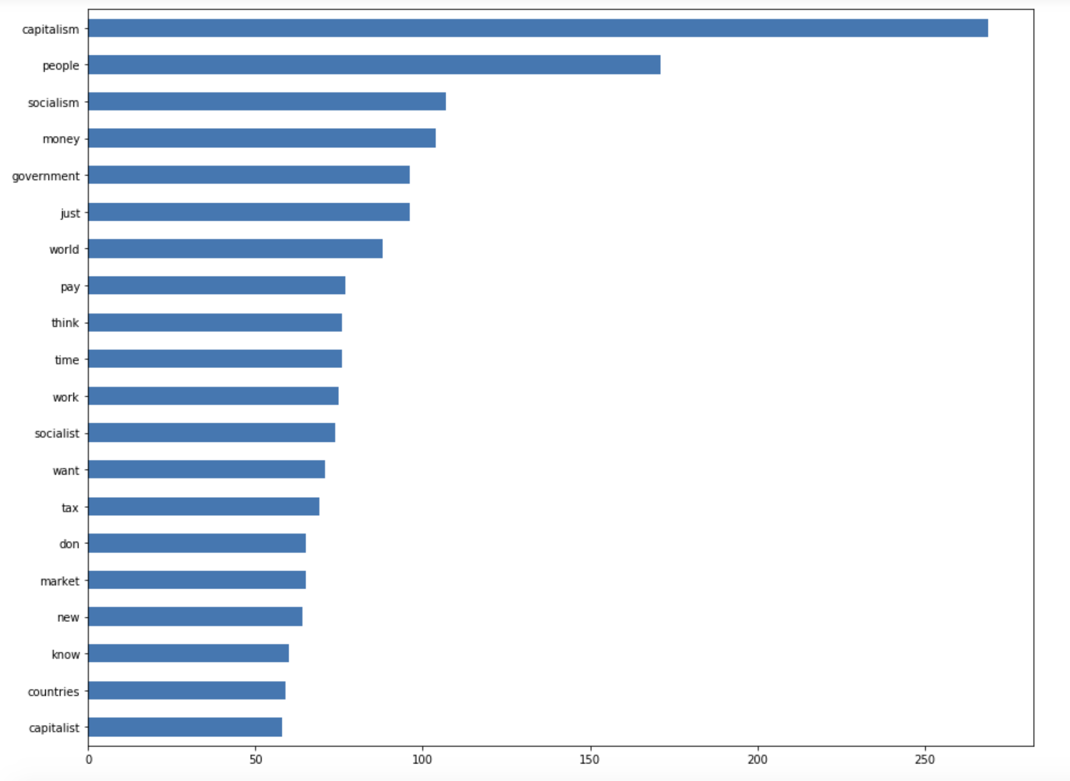
N-grams: (1, 1)
Top 5 words:
Capitalism
People
Socialism
Money
Government

Slide 7
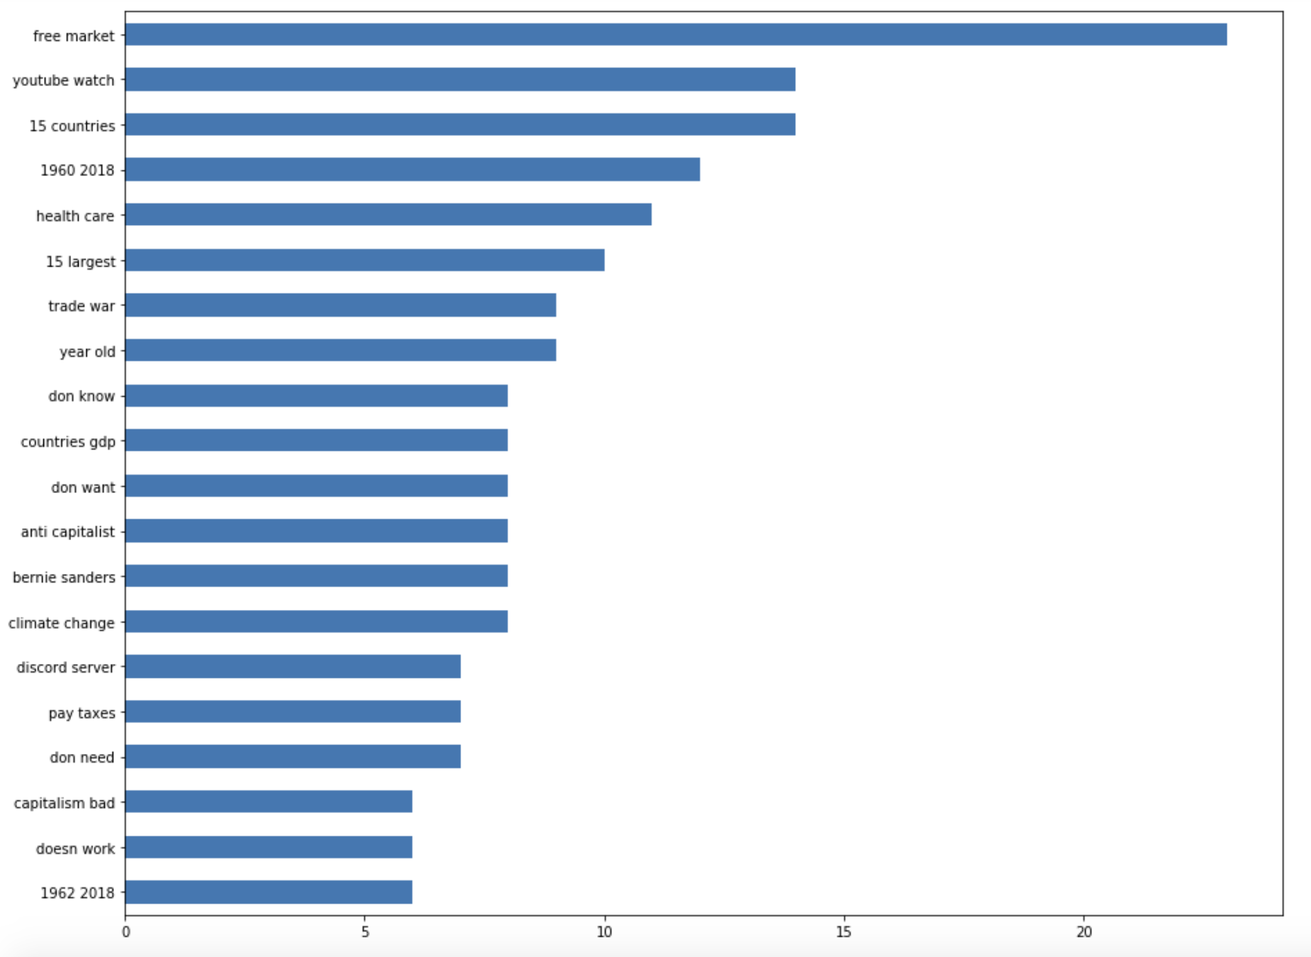
N-grams: (2, 2)
Top 5 word pairs:
Free Market
Youtube watch
15 countries
1960 - 2019
Health care

Slide 8
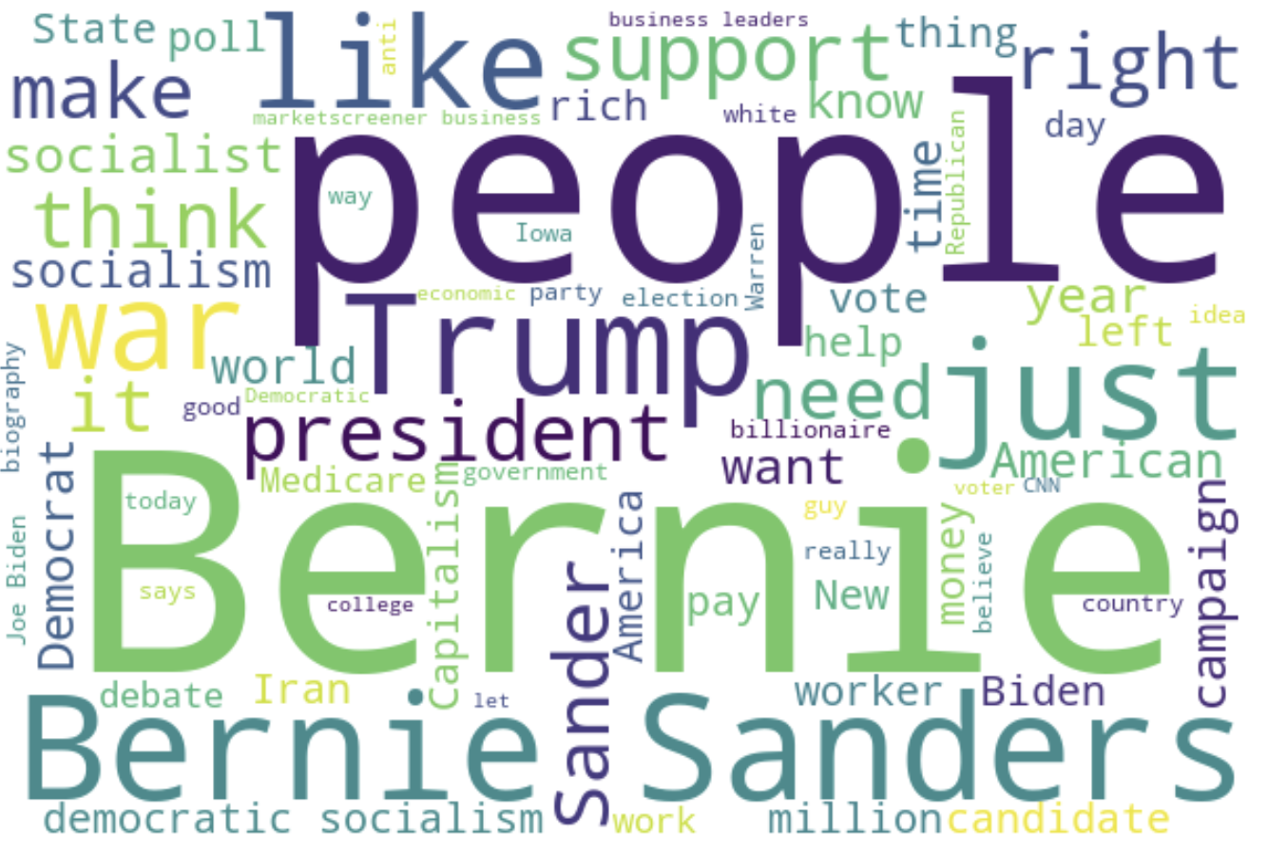

Slide 9
Mysterious Subreddit #2:
/r/democraticsocialism

Slide 10
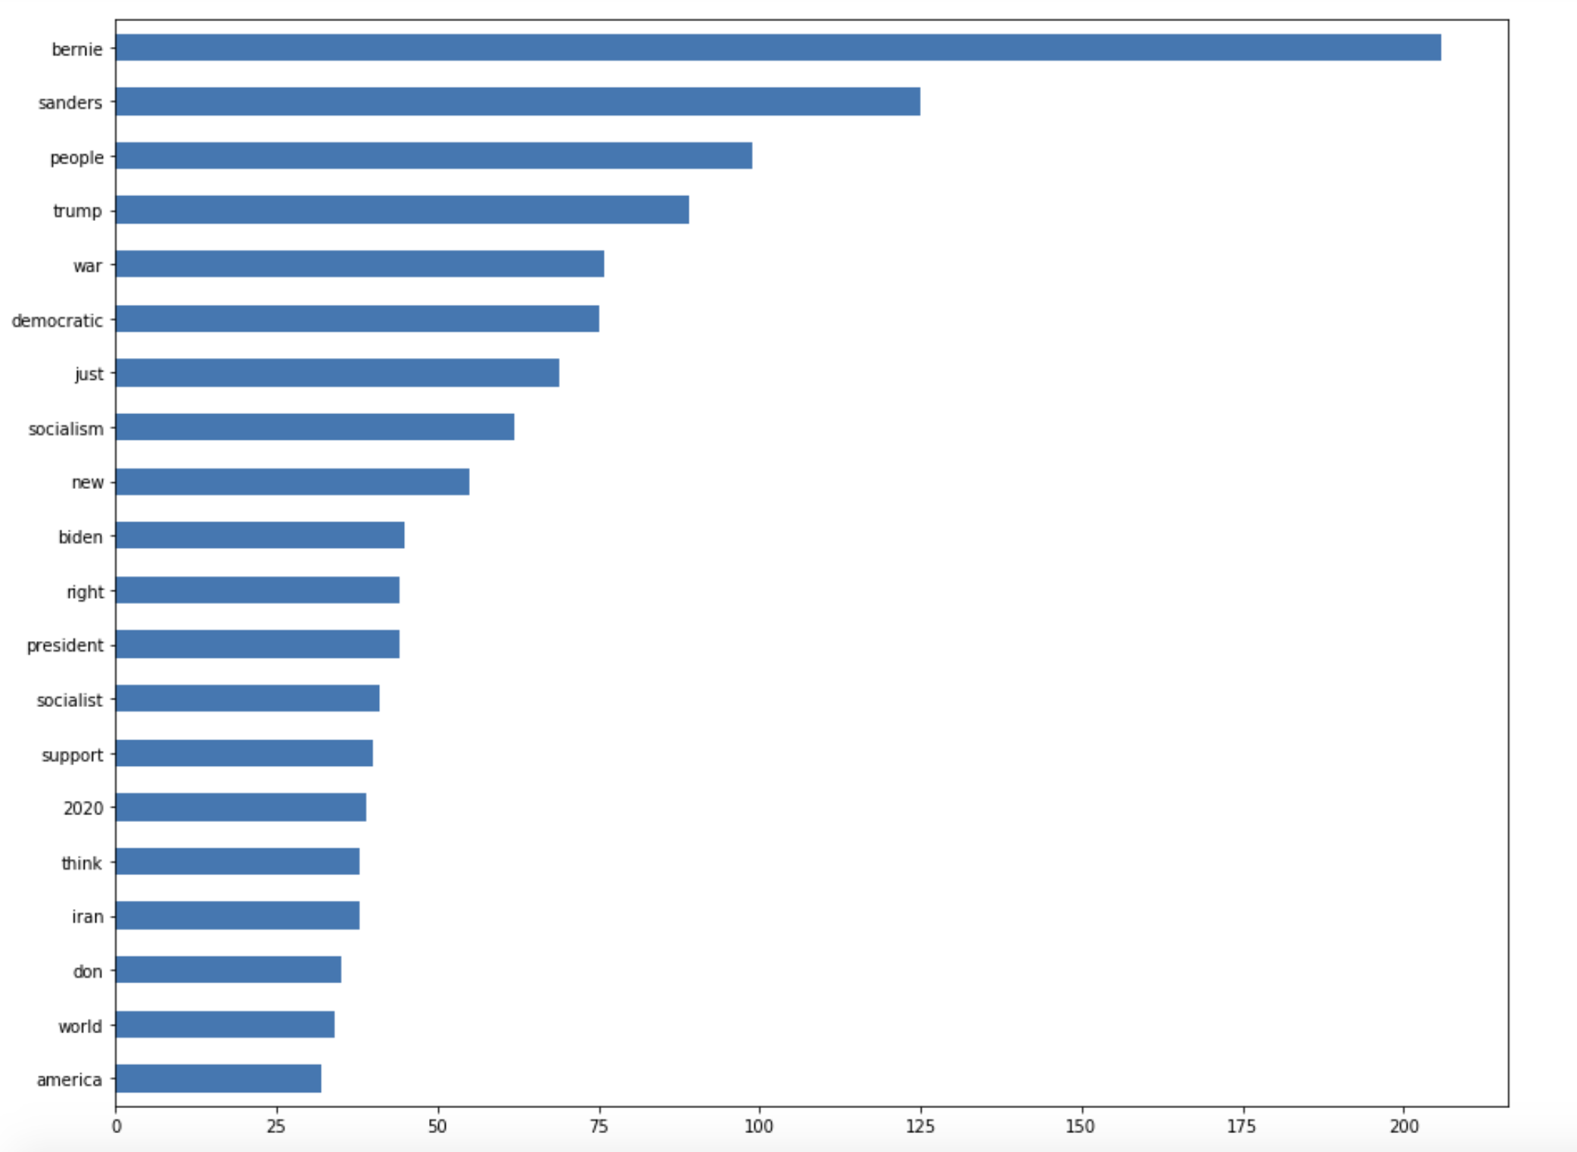
N-grams: (1, 1)
Top 5 words:
Bernie
Sanders
People
Trump
War

Slide 11
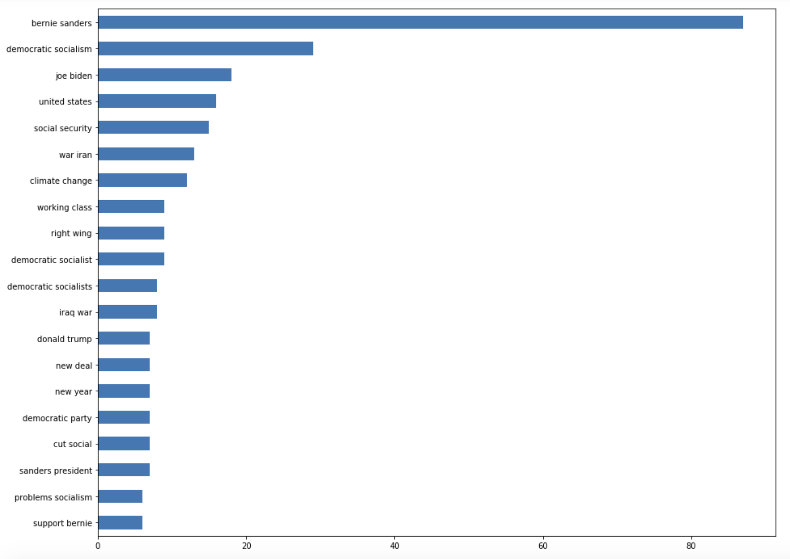
N-grams: (2, 2)
Top 5 word pairs:
Bernie Sanders
Democratic Socialism
Joe Biden
United States
Social Security

Slide 12

Meet the Multinomial Naive Bayes model.
It’s excellent for data whose features are all positive integers, and just look how positive and happy these kids look on that soccer field.

Slide 13
Multinomial NB modeling:
The highest accuracy score I obtained using a Multinomial NB model with a CountVectorizer:
76.97%
The highest accuracy score I obtained using a Multinomial NB model with a TfidfVectorizer:
76.18%

Slide 14


Meet the Logistic Regression model.
It has a wide range of uses. It’s frequently used for fitting features with binary classification, where it’s either one or the other but not both. You can’t be in Texas and California at the same time - just one of them.
….unless you’re in Dallas. Then you’re kind of in a snobby, pretentious L.A. neighborhood too.

Slide 15
Logistic Regression modeling:
The highest accuracy score I obtained using a Logistic Regression model with a CountVectorizer:
78.63%
The highest accuracy score I obtained using a Logistic Regression model with a TfidfVectorizer:
78.33%

Slide 16

Meet the Support Vector Machine model.
It’s used for vectors.
….yeah

Slide 17
SVM modeling:
The highest accuracy score I obtained using an SVM model with a CountVectorizer:
92.01%
The highest accuracy score I obtained using an SVM model with a TfidfVectorizer:
98.58%

Slide 18
Conclusion & Recommendations
Although some of the word results in these models seem like they would be more intuitive (e.g. "free market" and "money" in capitalism or "bernie" in democratic socialism), there are others like "climate change," "bernie sanders," "people," and "socialism" that make the top 20 in both subreddits. Some recommendations I would make for further analysis would be to separate the data into yearly segments, do a sentiment analysis, and look for overlap in authors to see if a small group of people are active on both subreddits.
Both of these subreddits are less than a decade old, and needless to say, politics has changed dramatically in that time. It could prove insightful to run models and analyses on each subreddit's threads for each calendar year they've existed. For example, looking at how something like sentiment analysis changes from year to year might reveal something significant about the subreddit origin of the words. A hypothesis for that specific analysis might be that, since the beginning of the threads' existence, the word "capitalism" has slowly become viewed more unfavorably each year (and the opposite for the term "democratic socialism"). It would be interesting to see if that societal trend is paralleled in these subreddits. If the hypothesis proves false, it could suggest that the culture in these particular subreddits is more unique to its individual authors (a small portion of the population that is active on Reddit) and not reflective of societal cultural in a broader sense.

